Slide 1
NodeJS
3rd October 2019

Slide 2
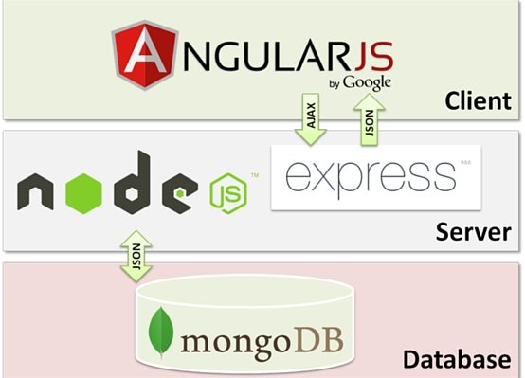
The MEAN stack
JavaScript-based technology stack for web services
Faster
Cheaper
Growing rapidly

Slide 3
NodeJS
A JavaScript runtime environment
Built on the V8 JS engine
Supports JS natively
Some other languages can be compiled to JS to make them compatible with Node, e.g. TypeScript
Event-driven programming for web servers
Single-threaded architecture, handles asynchrony using callbacks

Slide 4
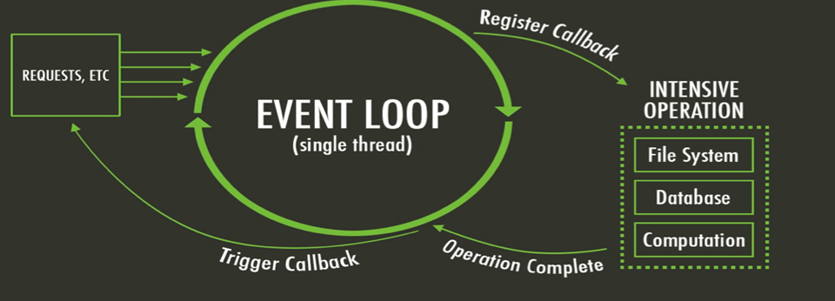
What is unique about Node.js?
Apache server will serve each web request as an individual thread
Node server will serve all requests in one thread
Lots of concurrent requests? Use Node.
Notes:
Thread based servers like Apache server will serve each web request as individual threads which doesn’t fit well for concurrent connections.

Slide 5
Threads VS Event-driven
Threads | Asynchronous Event-driven
Lock application / request with listener-workers threads | only one thread, which repeatedly fetches an event
Using incoming-request model | Using queue and then processes it
multithreaded server might block the request which might involve multiple events | manually saves state and then goes on to process the next event
Using context switching | no contention and no context switches
Using multithreading environments where listener and workers threads are used frequently to take an incoming-request lock | Using asynchronous I/O facilities (callbacks, not poll/select or O_NONBLOCK) environments

Slide 6
What can you do with Node ?
It lets you Layer on top of the TCP library as a HTTP and HTTPS server.
The JS is executed by the V8 javascript engine
Node provides a JavaScript API to access the network and file system.

Slide 7
What can’t you do with Node?
Node is a platform for writing JavaScript applications outside web browsers.
There is no DOM built into Node, nor any other browser capability.
Node can’t run on GUI, but run on terminal
Offers basic REPL capability

Slide 8
Event-based servers
A threaded web server, while processing the request, will have to wait for the IO operations and thus block the next request to be processed.
Node.JS processes each request as an event, doesn’t wait (non-blocking) for the IO operation to complete → it can handle other request at the same time.
When the IO operation of first request is completed it will call-back the server to complete the request.

Slide 9
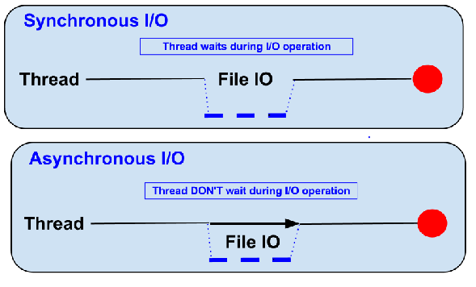
Blocking vs Non-Blocking……
Example :: Read data from file and show data

Slide 10
Blocking pattern
● Read data from file
● Show data
● Do other tasks
var data = fs.readFileSync( “test.txt” );
console.log( data );
console.log( “Do other tasks” );

Slide 11
Non-Blocking pattern
● Read data from file
When read data completed, show data
● Do other tasks
fs.readFile( “test.txt”, function( err, data ) {
console.log(data);
});

Slide 12
Node.js VS Apache
It's faster
It can handle tons of concurrent requests
Platform | Number of request per second
PHP ( via Apache) | 318727
Static ( via Apache ) | 296651
Node.js | 556930

Slide 13
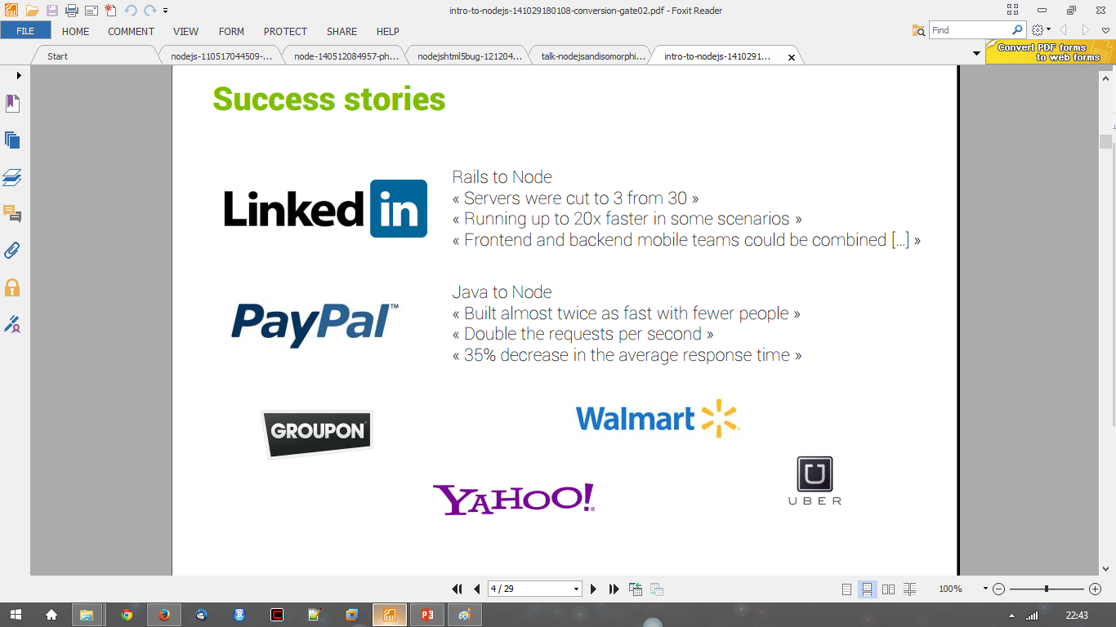
Success Stories…..

Slide 14
Supports HTTP requests
● GET
● POST
● PUT
● DELETE

Slide 15
Applications
● Web application
● Websocket server
● Ad server
● Proxy server
● Streaming server
● Fast file upload client
● Any Real-time data apps
● Anything with high I/O

Slide 16
Package.json
{
"name": "node-js-getting-started",
"version": "0.2.5",
"description": "A sample Node.js app”,
"engines": {
"node": "5.9.1"
},
"main": "index.js",
"scripts": {
"start": "node index.js"
},
"dependencies": {
"ejs": "2.4.1",
"express": "^4.13.3",
},
"repository": {
"type": "git",
"url": "https://github.com/nisheeths/first-node-app"
},
"keywords": [
"node",
"express"
],
"license": "MIT"
}
Project information
• Name
• Version
• Dependencies
• Licence
• Main file
Etc...

Slide 17
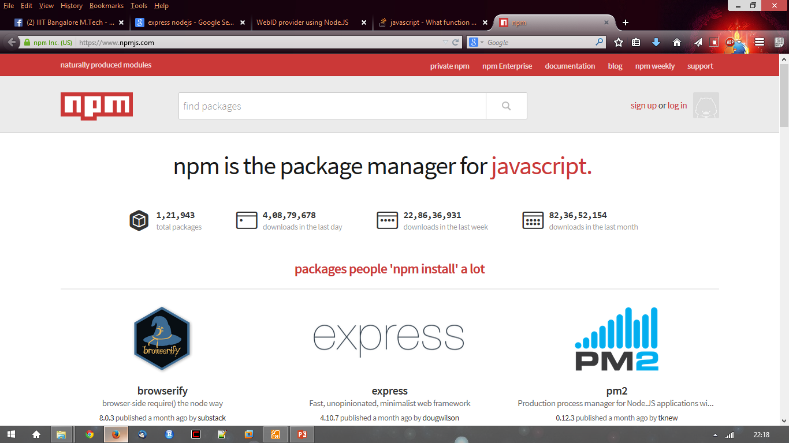
npm
● https://npmjs.org/
● # of modules = 1,21,943

Slide 18
Installing packages
Typical installation
npm install <package-name> --save
Installs package to your local project directory
Available to your web server
Global installation
Npm install –g <package-name>
Installs package to your development machine
Available in the shell

Slide 19
Using packages
var http = require(‘http’);
var fs = require(‘fs’);
var express = require(‘express’);
This will soon change, once Node adapts to the new ES7 standards
Likely later this year
import http from http;

Slide 20
Hello World Example
Create a directory
>mkdir myapp
>cd myapp
Use the npm init command to create a package.json file for your application.
> $ npm init
prompts you for a number of things, such as the name and version of your application. For now, you can simply hit RETURN to accept the defaults

Slide 21
Hello World example
Create file index.js with the following code:
http.createServer(function (request, response) {
// Send the HTTP header
// HTTP Status: 200 : OK
// Content Type: text/plain
response.writeHead(200, {'Content-Type': 'text/plain'});
// Send the response body as "Hello World“
response.end('Hello World\n'); }).listen(8081);
// Console will print the message
console.log('Server running at http://127.0.0.1:8081/');

Slide 22
Hello World example –package.json – describes application
{
"name": "helloworld", "version": "1.0.0", "description": "simple hello world app", "main": "index.js", "scripts": { "test": "echo \"Error: no test specified\" && exit 1" }, "author": "L. Grewe", "license": "ISC", "dependencies": { "express": "^4.14.1"
}
}

Slide 23
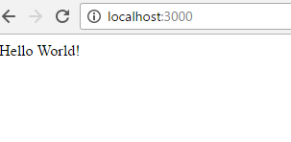
Run your hello world application
Run the app with the following command:
$ node first-app.js
Then, load http://localhost:8081/ in a browser to see the output.

Slide 24
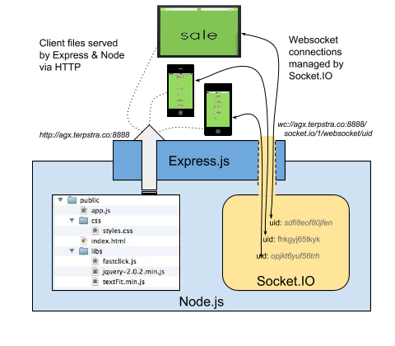
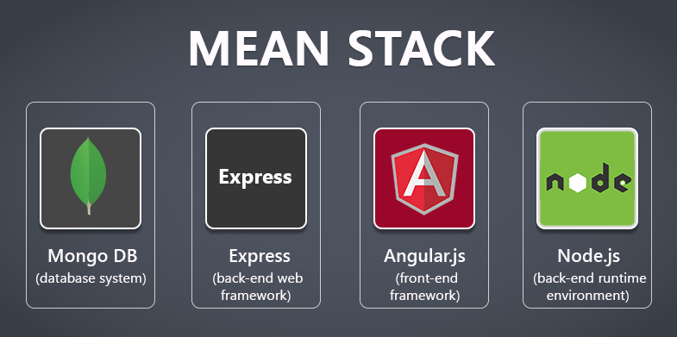
Express
Node.js web application framework that provides a robust set of features for web and mobile applications.

Slide 25
Express gives ease of functionality
Routing
Delivery of Static Files
“Middleware” – some ease in development (functionality)
Form Processing
Simple forms of Authentication
Cookies and Session Manipulation
A lot of this you can do in NodeJS but, you may write more code to do it than if you use the framework Express.
There are other alternatives than Express (the E in MEAN) like Sail, Meteor

Slide 26
Install express
install Express (if you want it, most will)and any other dependencies needed
Now install Express in the myapp directory and save it in the dependencies list. For example:
>$ npm install express --save

Slide 27
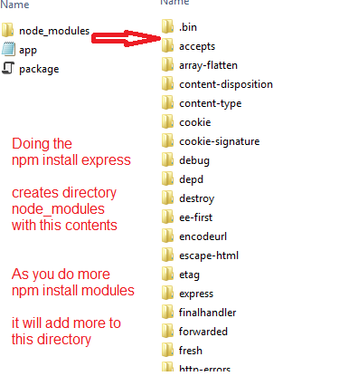
Express install
Will add files to the node_modules directory
If this is the first module you have installed for current application it will create the node_modules directory first.

Slide 28
ALTERNATIVE to install - generator
npm install express-generator -g express helloapp
create : helloapp
create : helloapp/package.json
create : helloapp/app.js
create : helloapp/public
create : helloapp/public/images
create : helloapp/routes
create : helloapp/routes/index.js
create : helloapp/routes/users.js
create : helloapp/public/stylesheets
create : helloapp/public/stylesheets/style.css
create : helloapp/views create : helloapp/views/index.jade
create : helloapp/views/layout.jade
create : helloapp/views/error.jade
create : helloapp/bin
create : helloapp/bin/www
install dependencies: $ cd helloapp && npm install
run the app: $ DEBUG=helloapp:* npm start
create : helloapp/public/javascripts

Slide 29
Express – hello world code
index.js have the code
var express = require('express')
var app = express()
app.get('/', function (req, res) {
res.send('Hello World!')
})
app.listen(3000, function () {
console.log('Example app listening on port 3000!')
})
This says requires module express
Calls function express to initialize object app
App object has various methods like get that responds to HTTP get request.
This code will call the function specified when a GET for the URI / is invoked
Sets up the HTTP server listening on port 3000

Slide 30
Next week in lab
Get your first couple of Node applications to run
Change the chat app such that
Username can only be set once
The color scheme is user-centered, viz. chats from others are one color, chats from the user are another color
Someone just joining the chat should see the whole stack of chat messages that came before

Slide 31
Your JavaScript app assignment
I said MEAN, but it can be MERN, CMAN, or any other stack, so long as its built on Node for back-end scripting
Project specs
Should have a mobile front-end
Should read and write to a database
Should perform at least two front-end view manipulations without pulling from the server
Should use at least on native mobile function
Should have login management, fine to use Passport
Should protect against XSS attacks

Slide 32
Future calendar
MongoDB
Front-end frameworks
Mostly React, some Angular
React Native
Mobile-specific functions
System integration principles

